Slide 1
Blockchain

Slide 2



Slide 3

9 pounds
Junfan
Shanglin

Slide 4

How it works
Junfan
Shanglin
9 pounds
9 pounds
Alipay

Slide 5


Slide 6
From: http://www.falibo.com/vocabulary/idiom-dont-put-all-your-eggs-in-one/

Slide 8
Blockchain
Distributed network
Everyone is a VIP

Slide 9

Traditional banking
Ledger

Slide 10
Bitcoin system
Blockchain

Slide 12
block
Junfan gets 20 pounds
Junfan pays Kish 1.5 pounds
Kish pays Sam 2 pounds
Sam pays Junfan 2 pounds
xxx gets 20 pounds
xx pays xx 1 pounds
xx pays xxx 3 pounds
xxx pays xxx 2 pounds

Slide 13
A
B

Slide 14


Slide 15


Add mine!
Add mine
Add mine
Add mine!!
?

Slide 16
Proof of work
I like people who work hard!
---Satoshi Nakamoto

Slide 17
How to define hard-working?

Slide 18
cryptography

Slide 19
Cryptographic hash function

Slide 20
HEAD
Junfan gets 12.5
Kish pays Sam 2
Random number
…
Junfan pays Kish 1.5
Sam pays Junfan 2
Junfan …

Slide 21
HEAD
Binary sequence (Hash value)
Junfan gets 12.5
Junfan pays Kish 1.5
Kish pays Sam 2
Sam pays Junfan 2
Junfan …
…
Random number
Bitcoin Reward
Transactions
Random number

Slide 22
Cryptographic hash function
Randomness
Pre-image resistance
Second pre-image resistance
Collision resistance

Slide 23
HEAD
Binary sequence (Hash value)
Award 12.5 to Junfan
Junfan pays Kish 1.5
Kish pays Sam 2
Sam pays Junfan 2
Junfan …
…
Random number
Bitcoin Reward
Transactions
Random number

Slide 24
256 bits
SHA256 (word) = 110001010101001…
(Hash value)
256 bits
SHA256 (world) = 001001010010111…
(Hash value)

Slide 25
1
…
Junfan pays Kish 1.5
Junfan gets 12.5
Pre hash
Kish pays Sam 2
Sam pays Junfan 2
SHA256 (
)
= 000000010010101010101010…
(Hash value)
256 bits

Slide 26
2
…
Junfan pays Kish 1.5
Junfan gets 12.5
Pre hash
Kish pays Sam 2
Sam pays Junfan 2
SHA256 (
)
= 011110001100101010010101…
(Hash value)
256 bits

Slide 27
3
…
Junfan pays Kish 1.5
Junfan gets 12.5
Pre hash
Kish pays Sam 2
Sam pays Junfan 2
SHA256 (
)
= 001101011111100000101010…
(Hash value)
256 bits

Slide 28
4
…
Junfan pays Kish 1.5
Junfan gets 12.5
Pre hash
Kish pays Sam 2
Sam pays Junfan 2
SHA256 (
)
= 111100010010101010101010…
(Hash value)
256 bits

Slide 29
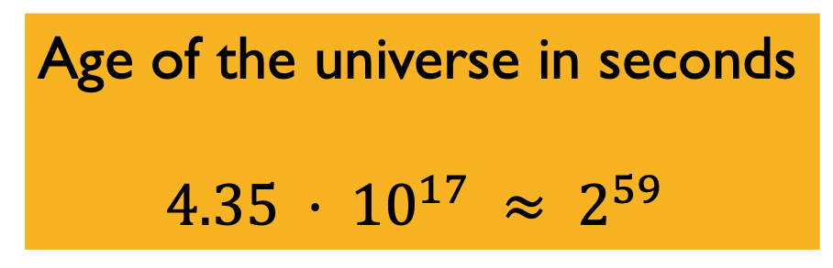
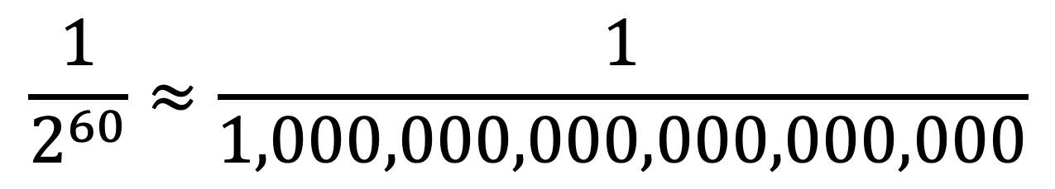
Valid block
SHA256(ledger)= 0000000..0010101010101010…
+number
How hard it is?
First N bits
Age of the universe in seconds
$$4.35 · {10}^{17} ≈ 2^{59}$$
N=60
$$\frac{1}{2^{60}}≈\frac{1}{1,000,000,000,000,000,000}$$

Slide 30
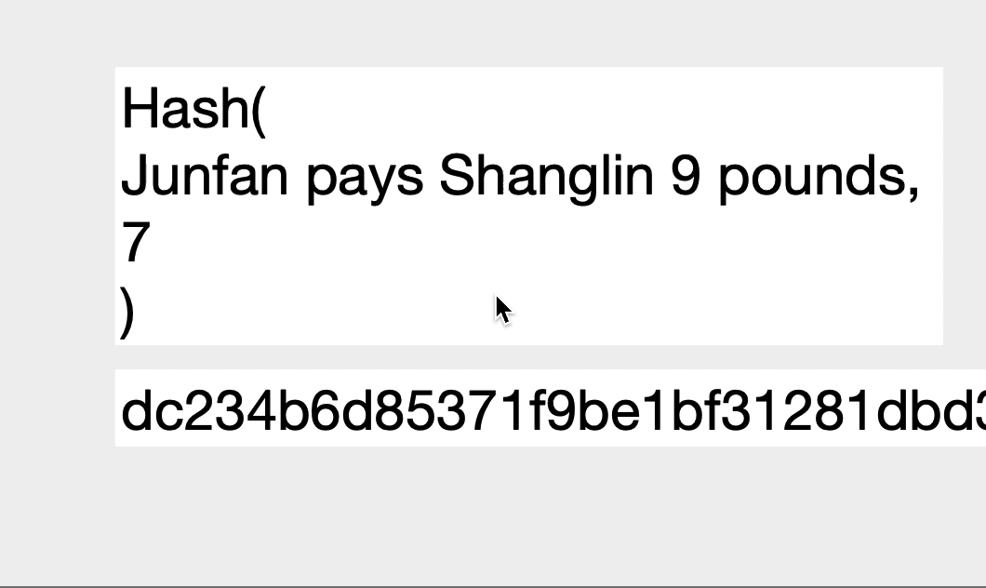
How to define hard-working?

Slide 31
Proof of work
It is a really hard work
Around every 10 min create a block
N can be changed
It makes sure the security

Slide 32
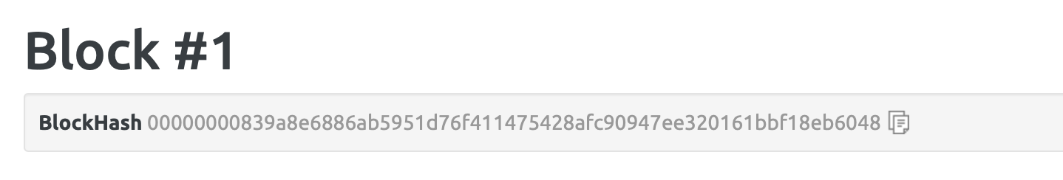
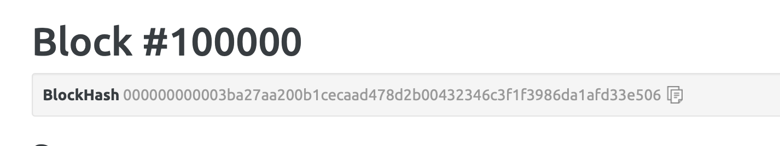
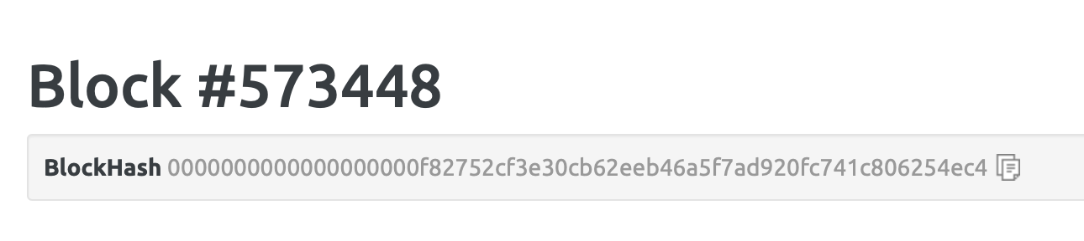
From: https://blockexplorer.com/block/

Slide 33
How to make sure it is secure?
0000010..
B pays D 30
A pays B 20
00000001..
L pays Q 30
0000001010..
A pays D 30
Random number
M pays B 20
Random number
A pays X 20
Random number
0000001010..
0000001010..
B pays D 30
J pays K 20
Random number
B pays D 30
A pays B 20
Random number

Slide 34
0000010..
B pays D 30
00000001..
L pays Q 30
0000001010..
A pays D 30
0000001010..
0000001010..
B pays D 30
B pays D 30
A pays B 20
Random number
M pays B 20
Random number
A pays X 20
Random number
J pays S 20
Random number 1
A pays B 20
Random number
0000001010...
B pays D 30
Random number 2

Slide 35
From: https://www.thegamer.com/avengers-marvel-memes-thanos-laughing-funny/

Slide 36
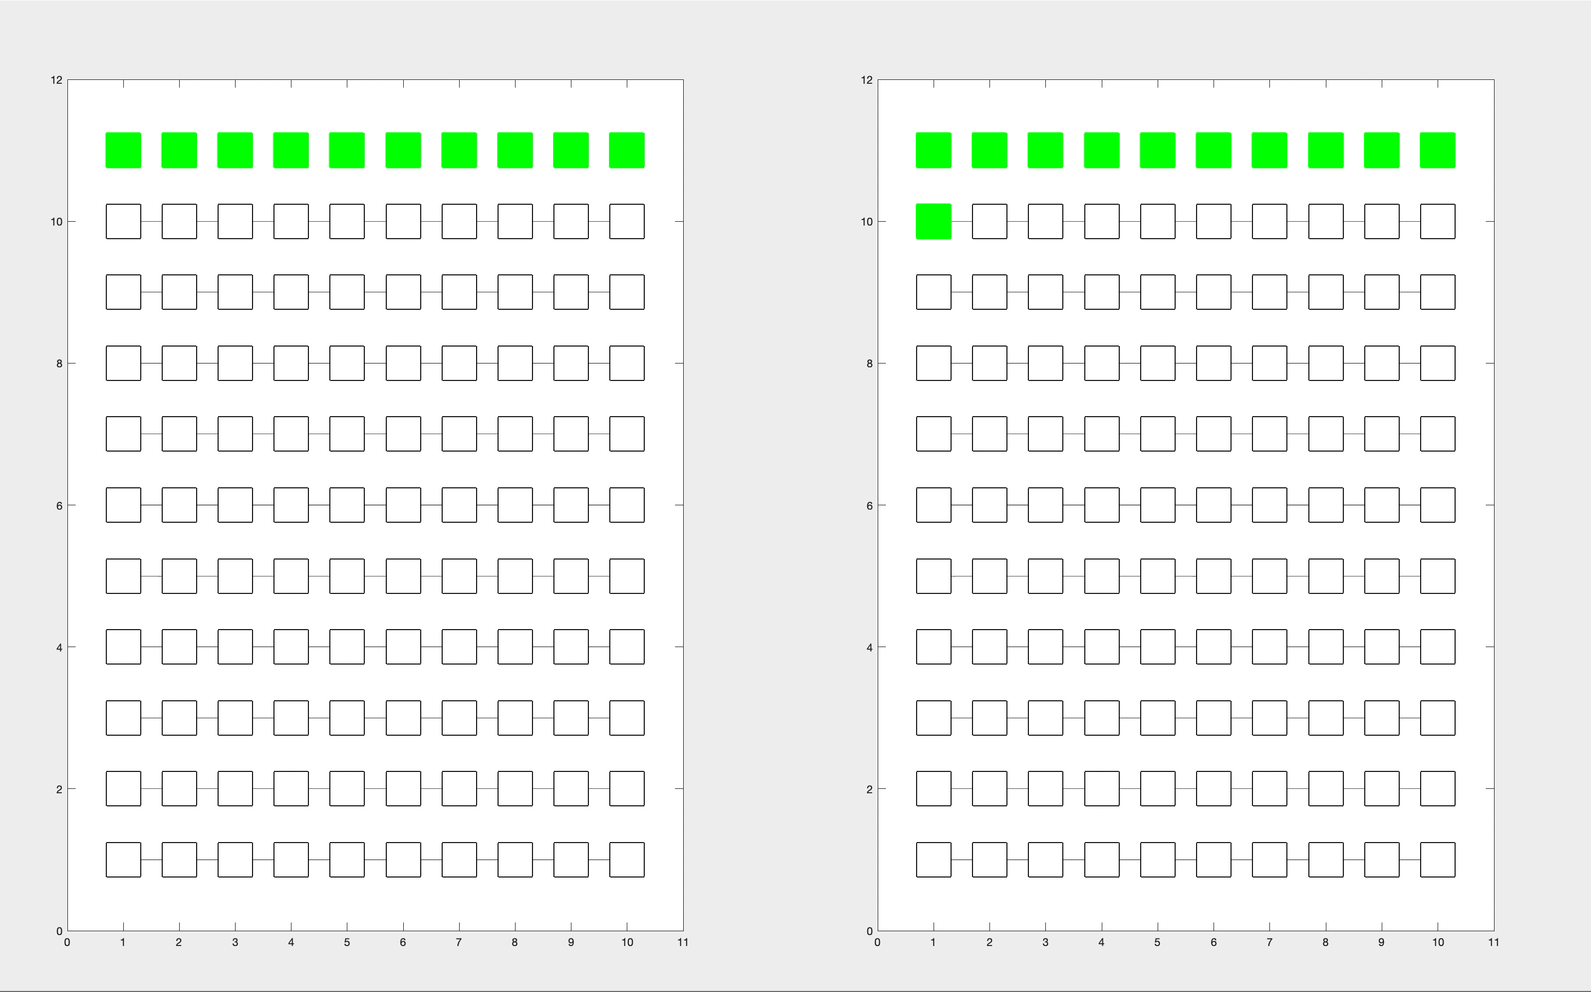

Slide 37
Blockchain
Record transactions
Finding the random number
Add it at the end of the main chain

Slide 38
Other Applications
Data Storage
Food supply chain
Donation
Insurance
…

Slide 39
Links
Blockchain Demo
https://anders.com/blockchain/blockchain.html
Block explorer
https://blockexplorer.com/block/

Slide 40
Thank you

Slide 41
Reference
[1] Nakamoto, S., 2008. Bitcoin: A peer-to-peer electronic cash system. Vancouver
[2] Nygaard, R., 2018. Distributed Storage with Strong Data Integrity based on Blockchain Mechanisms (Master's thesis, University of Stavanger, Norway).
[3] Tse, D., Zhang, B., Yang, Y., Cheng, C. and Mu, H., 2017, December. Blockchain application in food supply information security. In 2017 IEEE International Conference on Industrial Engineering and Engineering Management (IEEM) (pp. 1357-1361). IEEE.
[4] Lin, I.C. and Liao, T.C., 2017. A Survey of Blockchain Security Issues and Challenges. IJ Network Security, 19(5), pp.653-659. Vancouver

